Slide 1
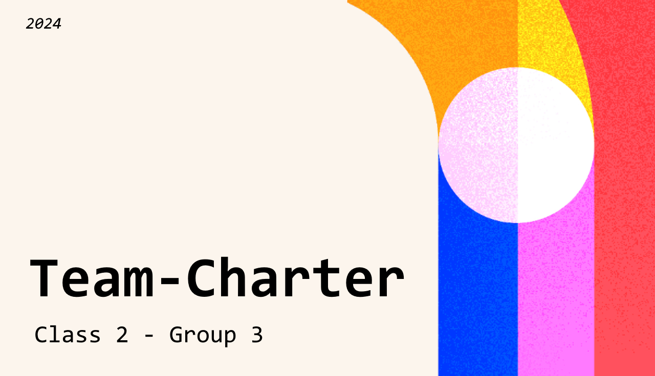


CONSIDER to AGREE on | Agreements | If needed, how do we correct each other?
TIME When should we meet as a team? How do we set up deadlines? How do we remind ourselves to stick to the planning we created? | If something is hindering you from showing up to school, make sure to let the team know on time! The baseline for meeting is daily, however, if something unexpected happens, then make sure to follow agreement #1. Deadlines are discussed and set at the beginning of the week -> Monday morning 10 AM. All teammates are expected to adhere to their roles and set deadlines. | Remind each other of the deadlines if you notice someone’s stuck or falling behind in their task. -> Figure out a solution together to prevent falling behind in the project.
DECISION MAKING How do we decide who makes what in a way that balances the workload and learning outcome content? How do we decide what good decisions are for our project / How did we make strong decisions that each team member (at least somewhat) agrees with? If most of the team agrees with a decision, online or offline, the decision is confirmed / set in motion. | If present, you are expected to participate in decision-making “meetings”. (TIME #3) (-> Present also means online (meetings) These shouldn’t take longer than 30 minutes.) If absent you will not (initially) be included in the decisions made that day unless open to live communication. -> If you already had a task beforehand or during, you are expected to keep working on that until the task is finished. - Done? Ask team for your new task.
PARTICIPATION How do we ensure everyone shows equal participation and contribution to the project? How are we going to keep everybody is up-to-date to ensure active participation? How do we keep everyone motivated to keep working on the project? | Clear communication is key. This also counts as active participation as this will keep you updated and makes sure you're not dealing with a too big workload. By using Trello and checking this in the morning, everyone is up to date in their respective tasks. -> Ties into the meeting on Monday morning, 10 A.M To ensure a fun and not too serious team dynamic, we make sure to take breaks and keep ourselves from getting too stressed out about our tasks /workload.
EXPECTATIONS How do we create a baseline for expectations within the group? What do we expect the quality of our work to be? What do we expect from the group in terms of communication? | Everybody is expected to adhere to the team charter, to take their work seriously and to finish their work on set deadlines. If the delivered work is not up to standard of the rest of the previously delivered work, a feedback session will be held to improve the quality of the work. You are expected to keep open communication to talk out anything that might be bothering you (in a professional manner!) and to be at school, when possible, to make sure communication is as clear as possible.

